Slide 1

Iteration 4:: “The Marketeers”
Team Leader: Michael Ellerkamp
Members: Raquel Trejo, Ahla Cho

Slide 2

Functional Requirements
R1. The System, hereby called Market, may create a database of World of Warcraft items.
R2. The Items may contain buy price, sell price, number sold & item ID.
R3. The User may easily search for items that cost less to buy than to sell.
R4. The User may select what server the User wishes to browse item data from.
R5. The User may Load and Run pre-made algorithms from the website.
R6. The User may input and run personal algorithms.
R7. The User may see the top 10 items with the most increase in sell value and most decrease in sell value.
R8. The User may search for items and see a short history of the item’s price.
R9. The User may consult a help guide for quick answers.

Slide 3
Nonfunctional Requirements
R1. Online apps
R2. Limited mount of server space
R3. Query response time
R4. semi hourly database update
R5. Method limits API

Slide 4
Use Case Diagram
Market
Search
Market
Load
Start up
Change Server
Shutdown
Help
User
Admin
Top 10 least sold
Top 10 increase
Top 10 Decrease
Top 10 Most sold

Slide 5
Expanded Use Case: Top 10 increase in price
Precondition: User is at Home Section
Actor: User | System: Market
 | (0)Market displays homescreen GUI
(1)TUCBW User clicks top 10 highest gain | (2) Market calling the top 10 increased controller to search and display up to 10 items that have the highest increase in price since last hour.
(3) TUCEW User see list

Slide 6
Sequence Diagram: Get TOP 10 items increase in price

Slide 7
Expanded Use Case: Top 10 decrease in price
Precondition: User is at Home Section
Actor: User | System: Market
 | (0)Market displays homescreen GUI
(1)TUCBW User clicks top 10 decrease. | (2) Market calling the top 10 decrease controller to search and display up to 10 items that have the highest decrease in price since last hour.
(3) TUCEW User see list

Slide 8
Sequence Diagram: Get TOP 10 items decrease in price

Slide 9
Expanded Use Case: Search
Precondition: User is at Search Section
Actor: User | System: Market
 | (0)Market displays Search GUI
(1)TUCBW User enters an item’s full or partial name into Search Bar then click Search. | (2) Market calling the search controller to search for items with full or partial match and lists them.
(3) Selects the item they wish to view. | (4) Market displays data about selected item.
(5) TUCEW User reads data.

Slide 10
Sequence Diagram: Search

Slide 11
Expanded Use Case: Change Server
Precondition: User is at any section.
Actor: User | System: Market
 | (0)Market displays section GUI
(1)TUCBW User clicks change server icon | (2) Market calling the server controller displays server list.
(3) User selects desired server. | (4) Market load data from that server.
(5) TUCEW User returns to original section with new server data.

Slide 12
Sequence Diagram: Change Server

Slide 13
Expanded Use Case: Load
Precondition: User is at algorithm section.
Actor: User | System: Market
 | (0)Market displays algorithm GUI
(1)TUCBW User enters name of item to be searched for. | (2) Market finds a list of items with full or partial matching names.
(3) User selects desired item | (4) Market displays data about item
(5) User selects pre-set algorithm to apply to item | (6) Market applies algorithm to item’s sell history.
(7) TUCEW User interprets data.

Slide 14
Expanded Use Case: Test
Precondition: User is at Test section.
Actor: User | System: Market
 | (0)Market displays test GUI
(1)TUCBW User enters name of item to be searched for. | (2) Market finds a list of items with full or partial matching names.
(3) User selects desired item | (4) Market displays data about item
(5) User enters custom algorithm to apply to item | (6) Market applies algorithm to item’s sell history.
(7) TUCEW User interprets data.

Slide 15
Sequence Diagram: Algorithm(load/test)

Slide 16
Expanded Use Case: Start up
Precondition
Actor: Admin | System: Market

Slide 17
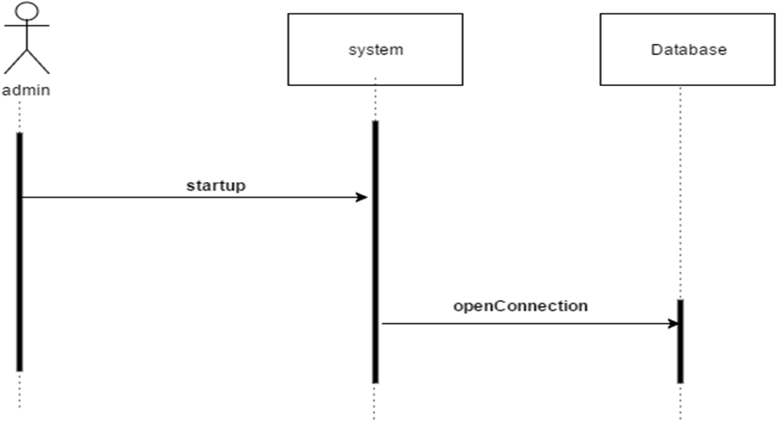
Sequence Diagram: start up

Slide 18
Expanded Use Case: Shut down
Precondition:
Actor: Admin | System: Market

Slide 19
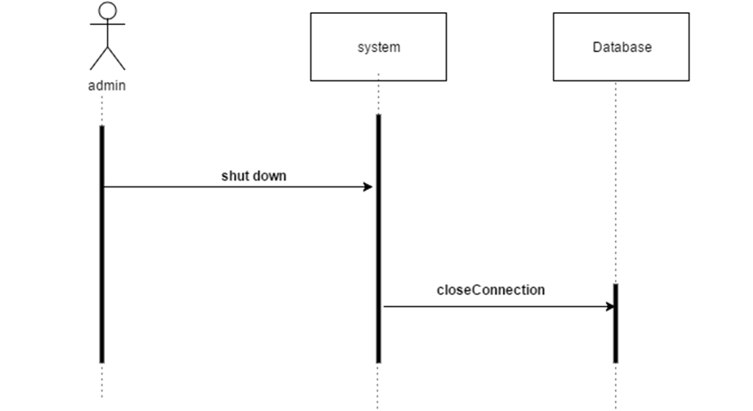
Sequence Diagram: Shut Down

Slide 20
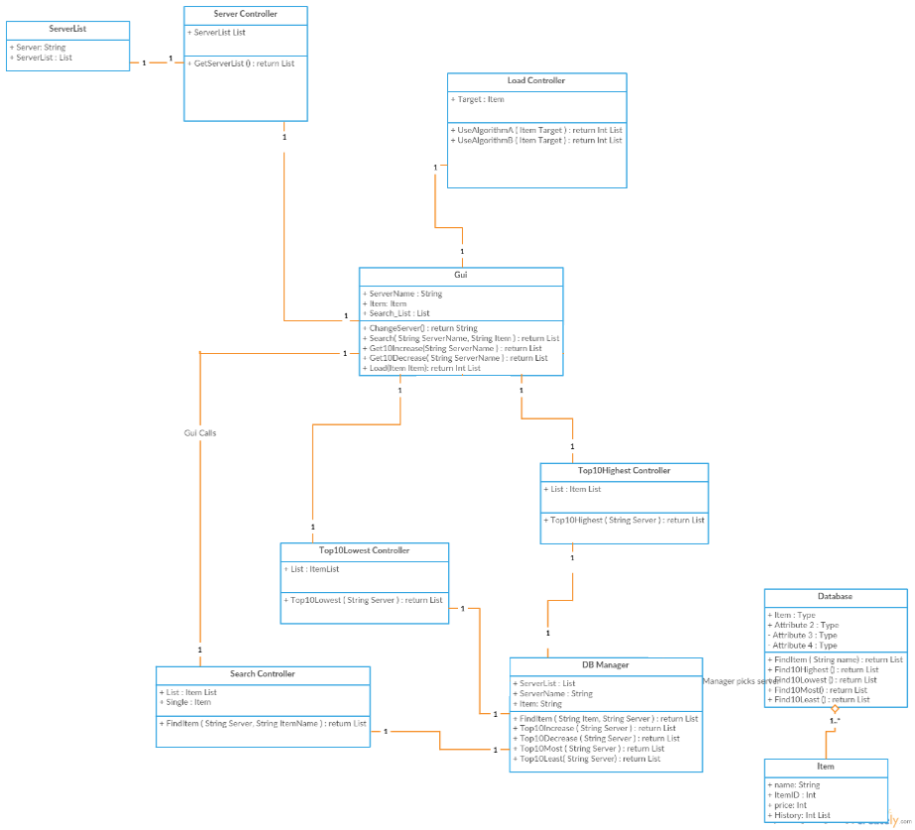
Domain Model

Slide 21
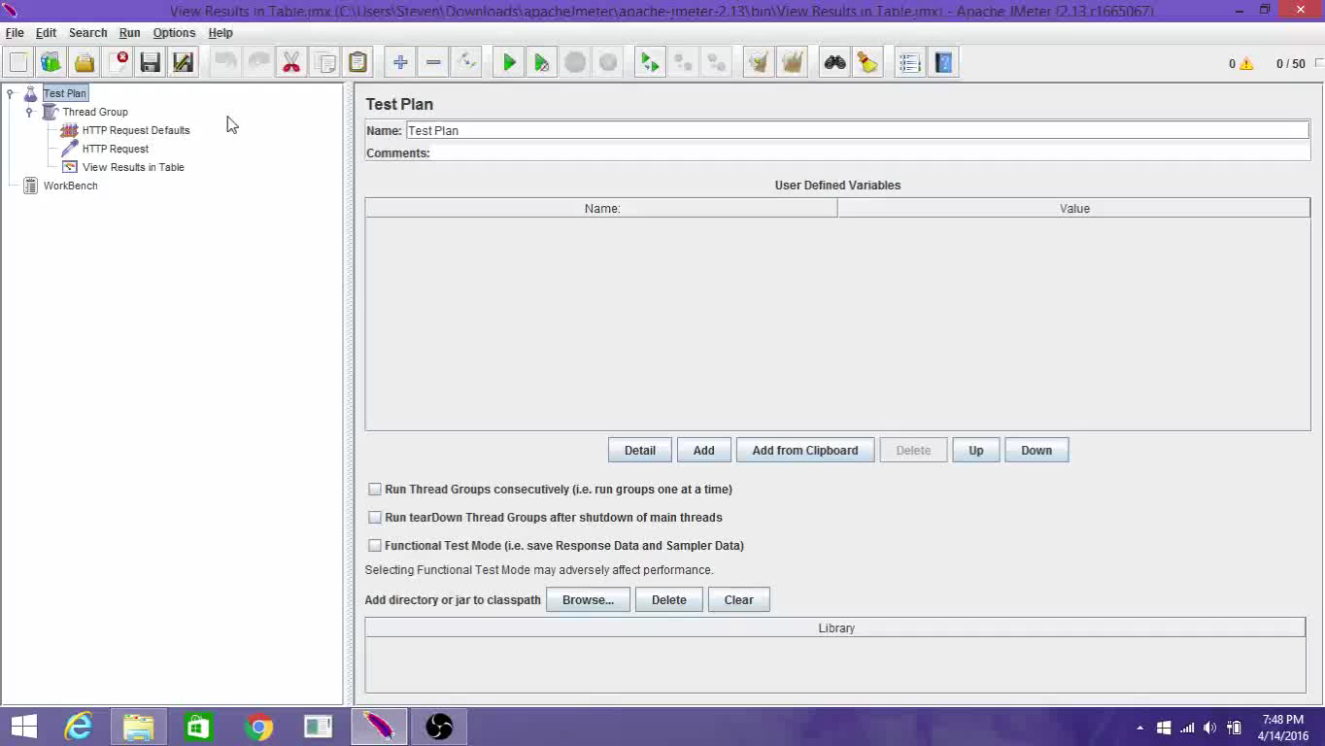
Testing- Apache Jmeter

Slide 22
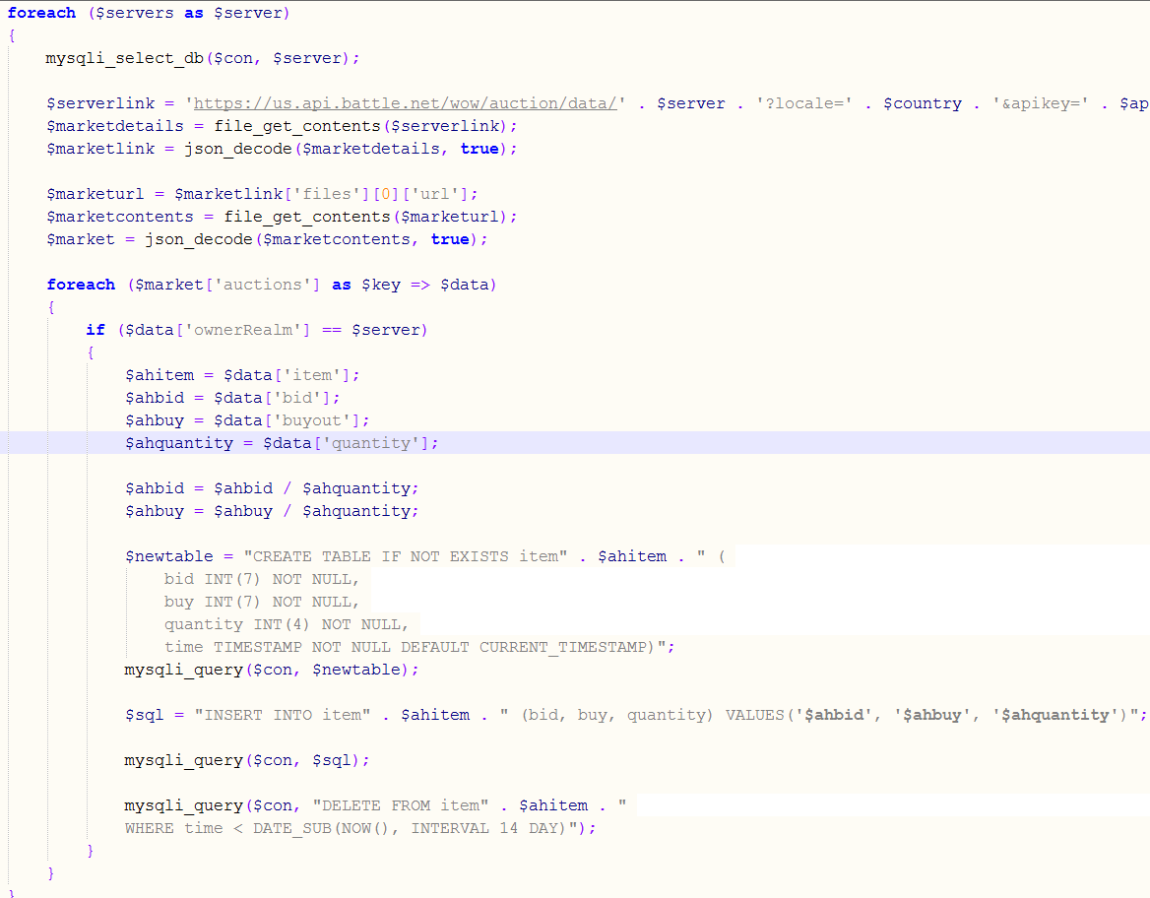
WoW.PHP

Slide 23
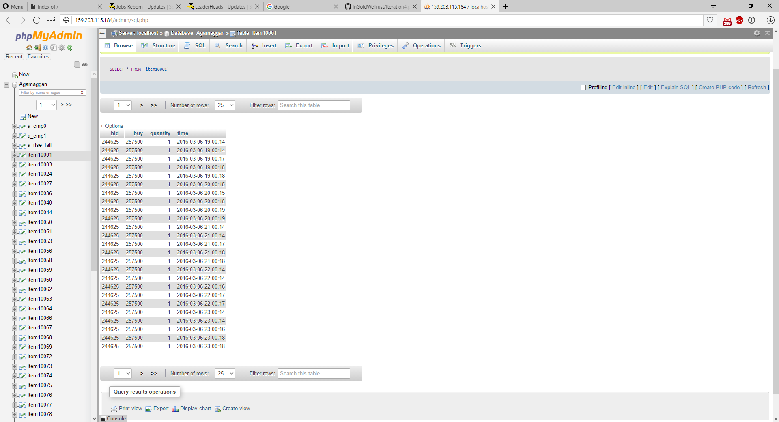
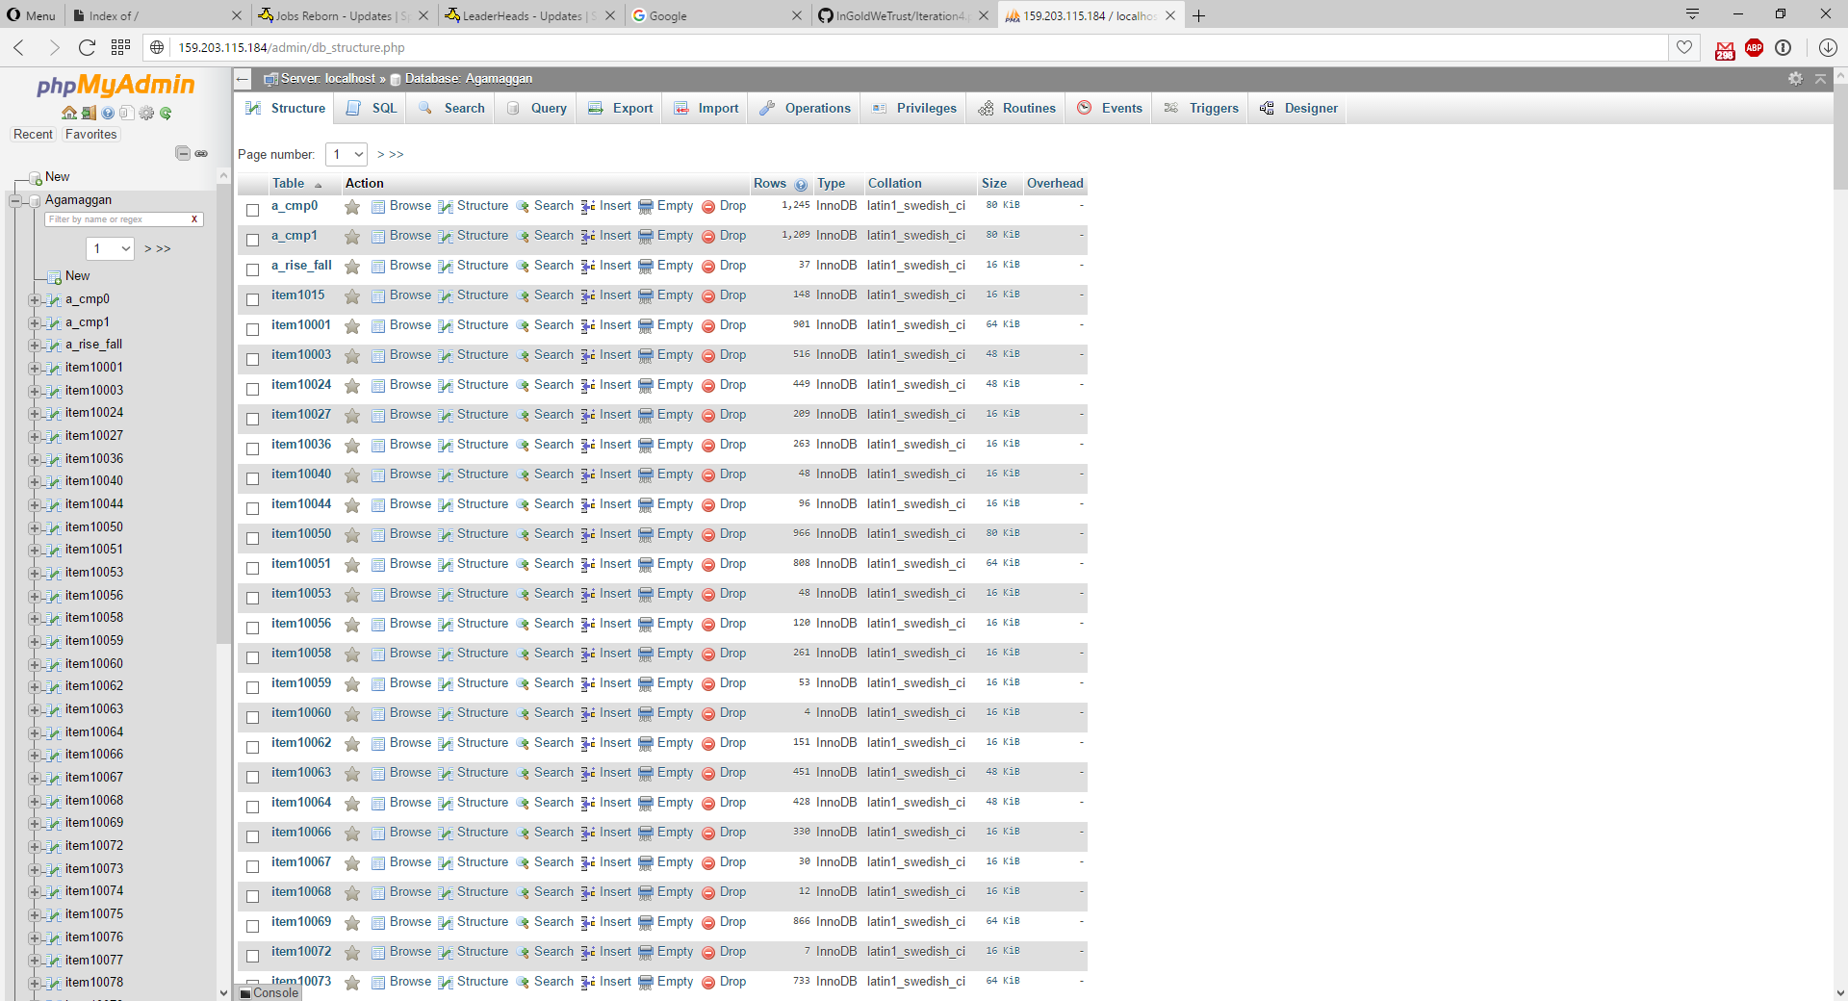
Results

Slide 24
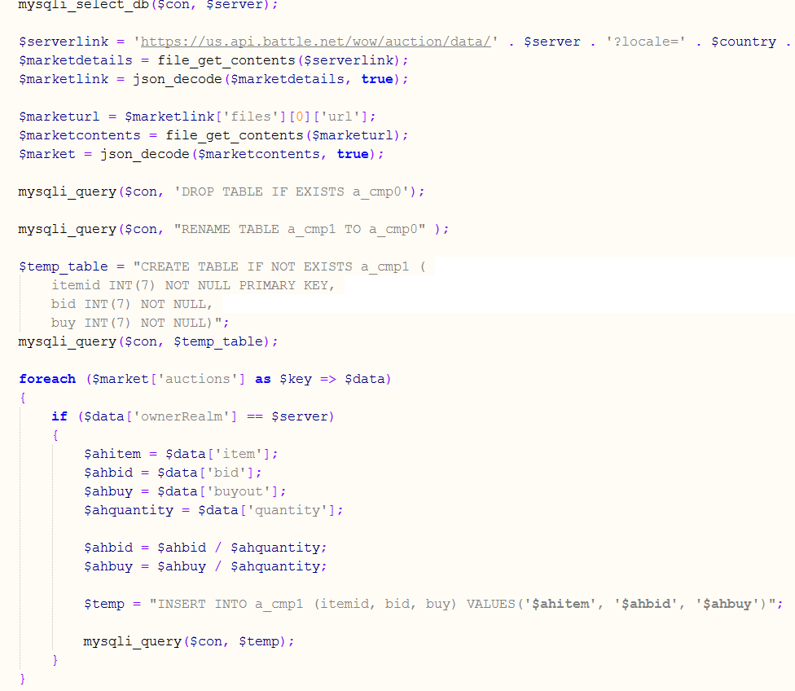
Temp.PHP

Slide 25
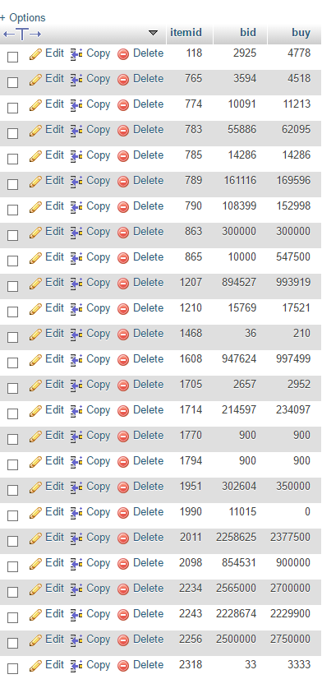
Results

Slide 26
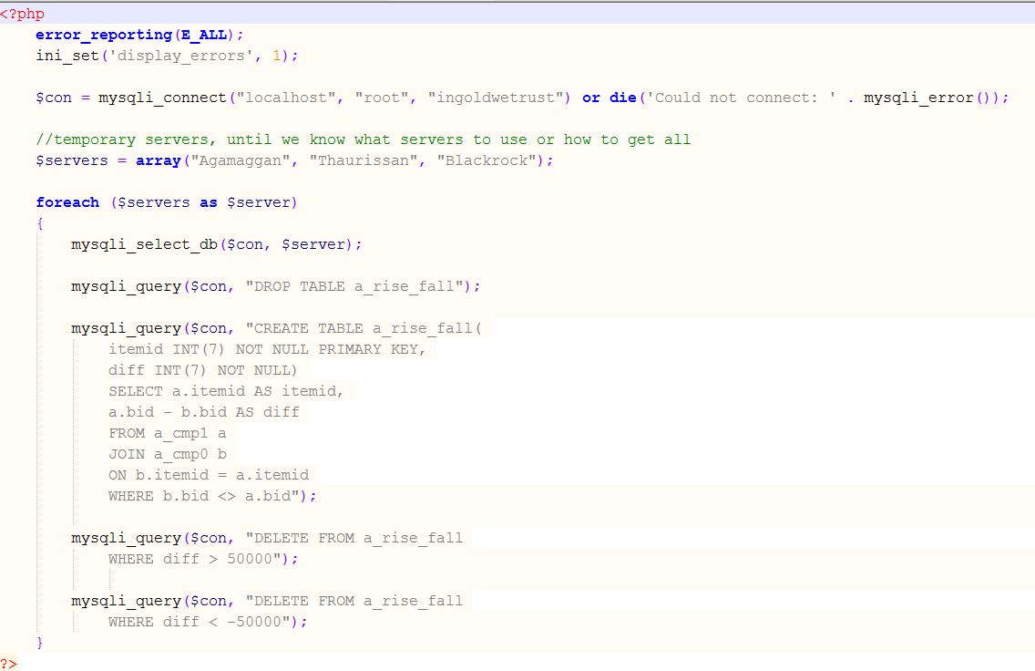
Home_Data.PHP

Slide 27
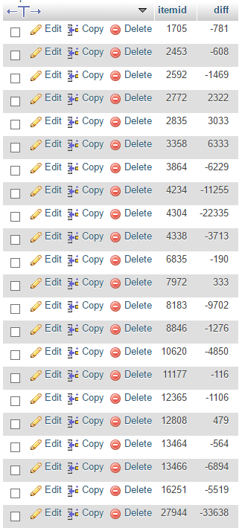
Results

Slide 28
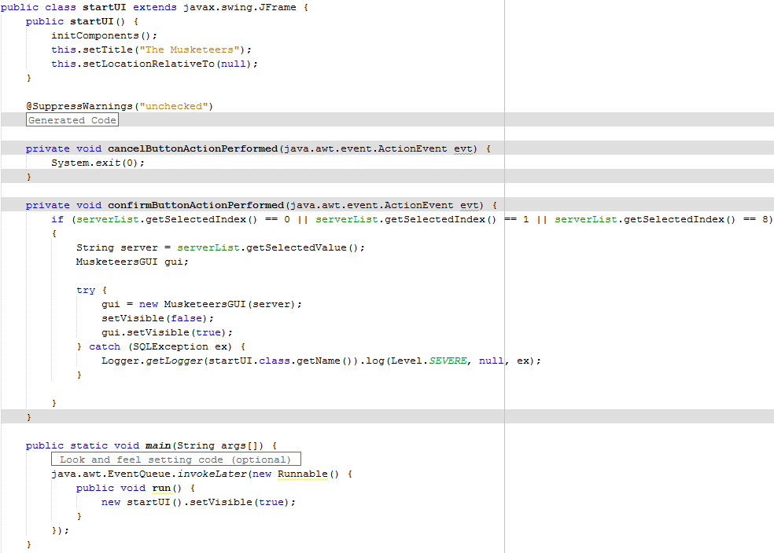
StartGUI

Slide 29
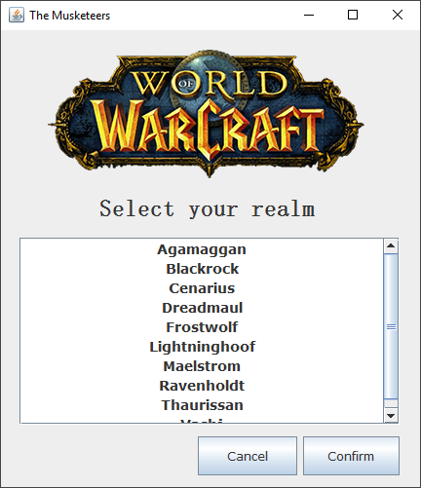
Result

Slide 30
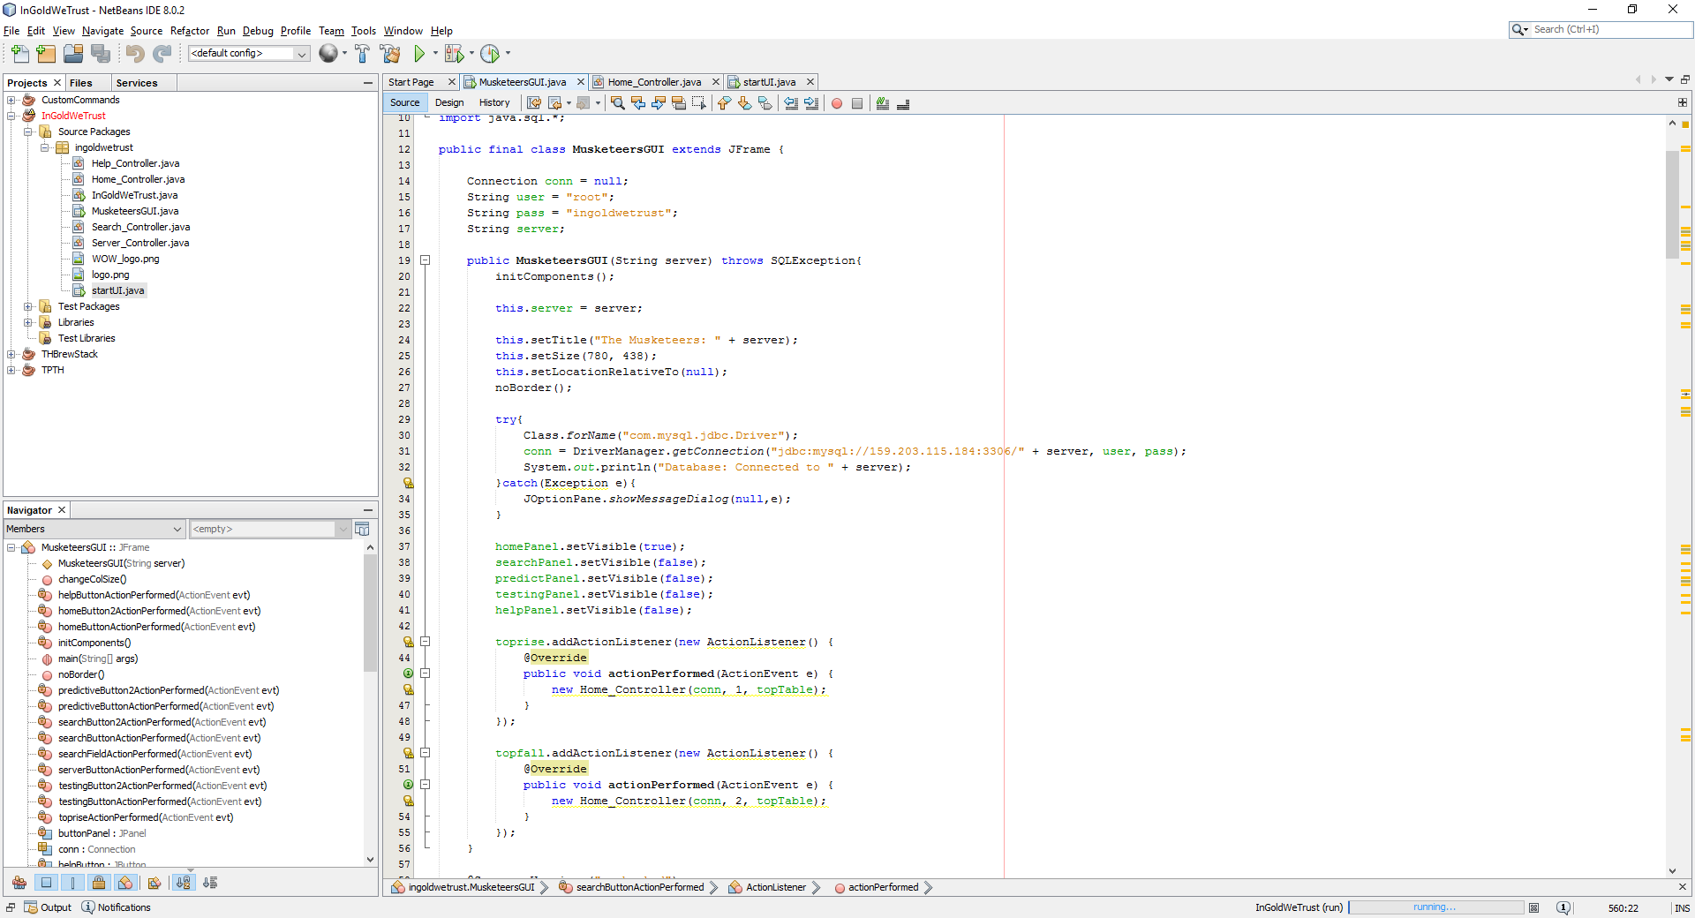
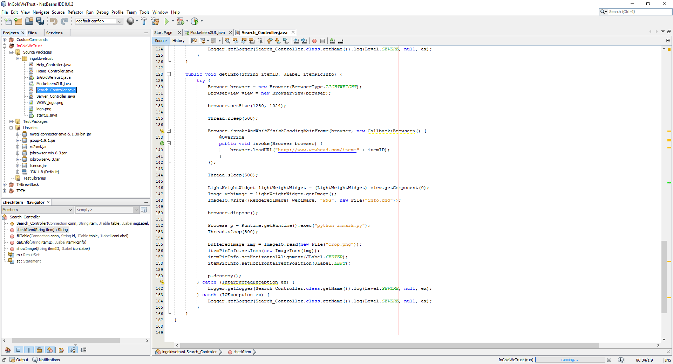
MusketeersGUI

Slide 31
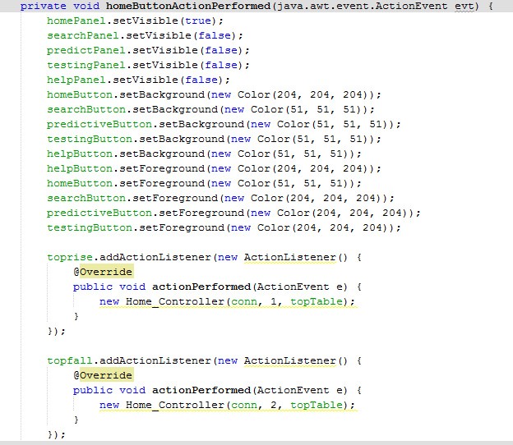
HomeAction

Slide 32
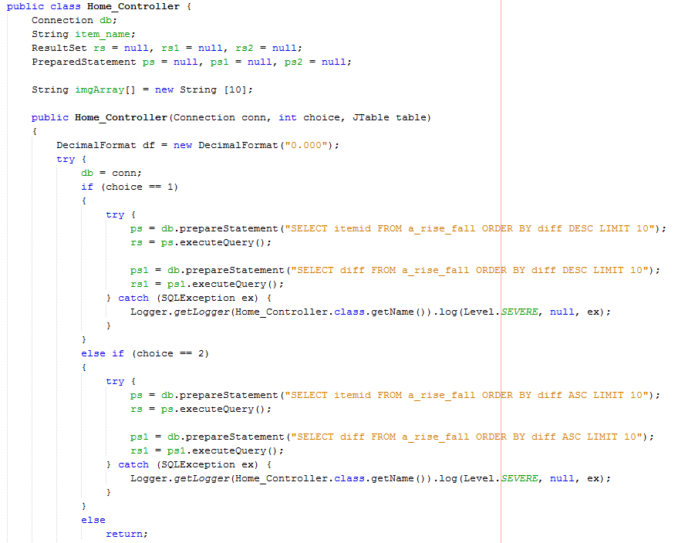
Home_Controller

Slide 33
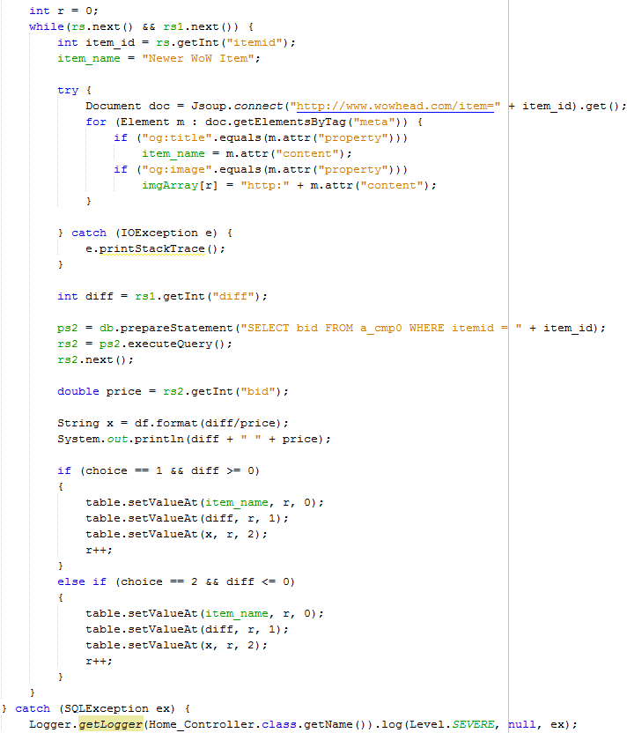
Home_Controller cont.

Slide 34
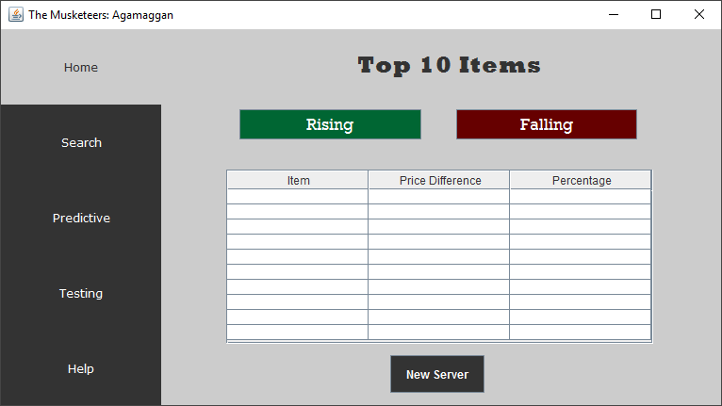
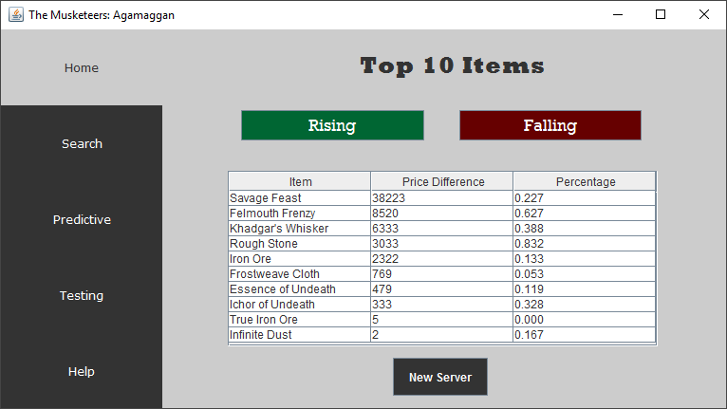
Results

Slide 35
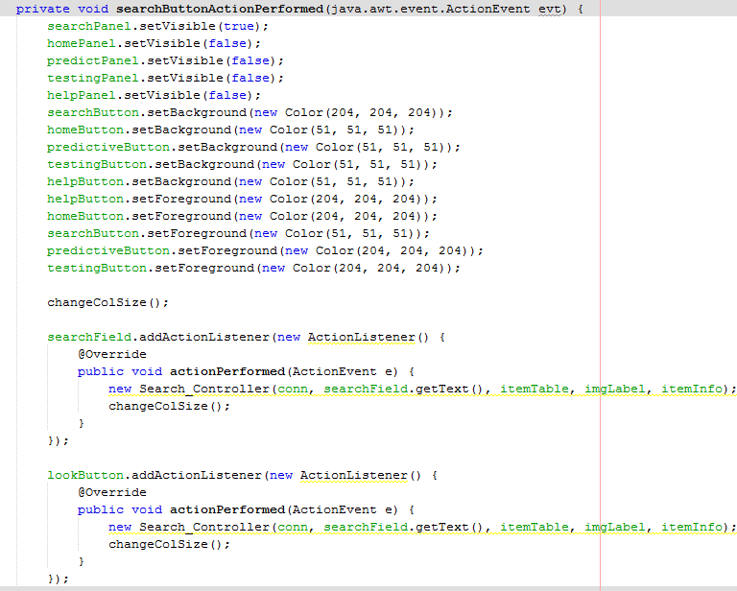
SearchAction

Slide 36
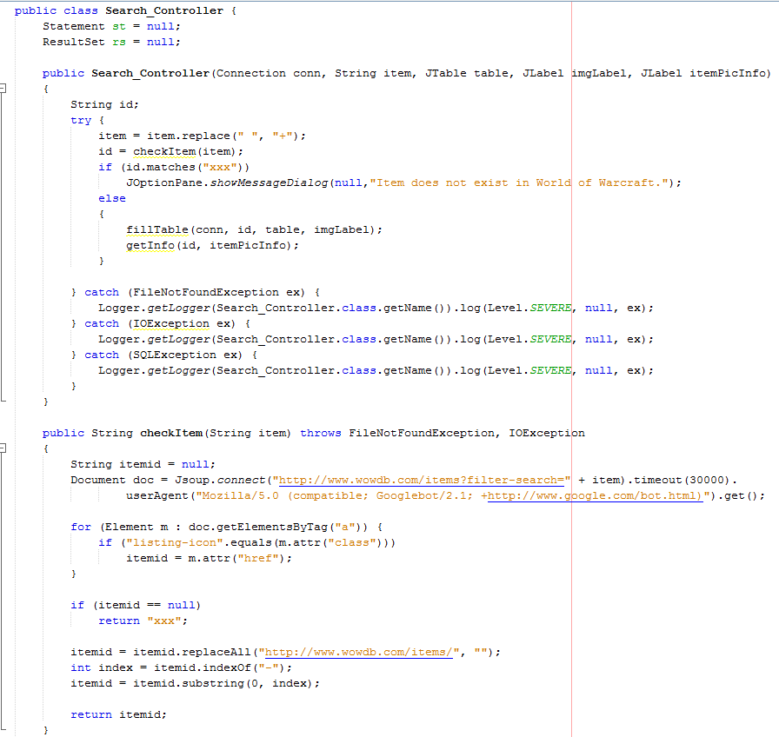
Search_Controller

Slide 37
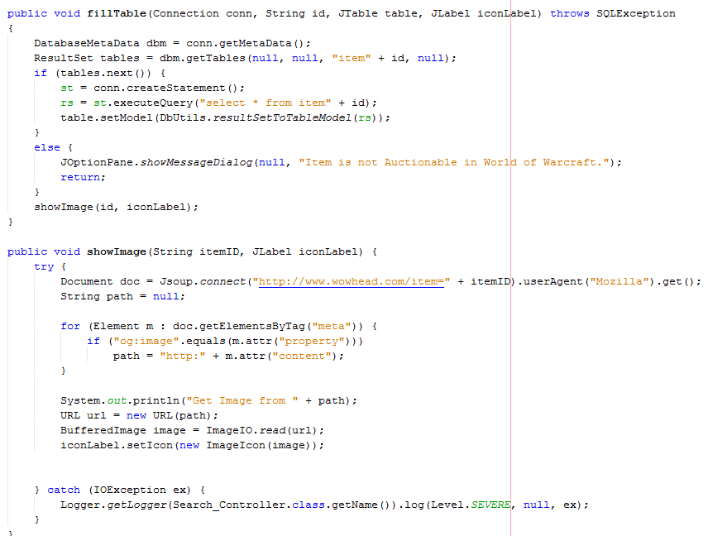
Search_Controller cont.

Slide 38
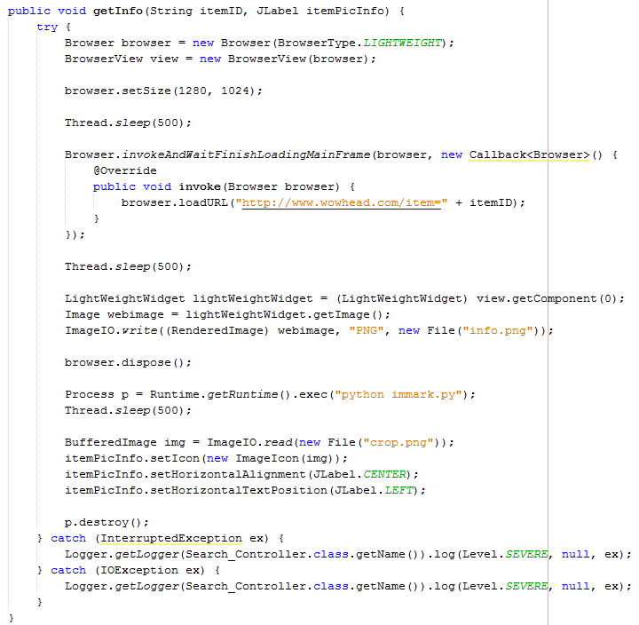
Search_Controller cont.

Slide 39
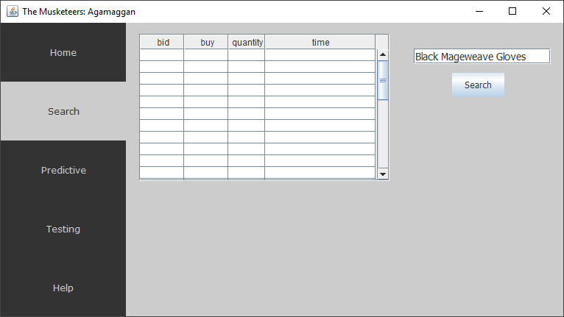
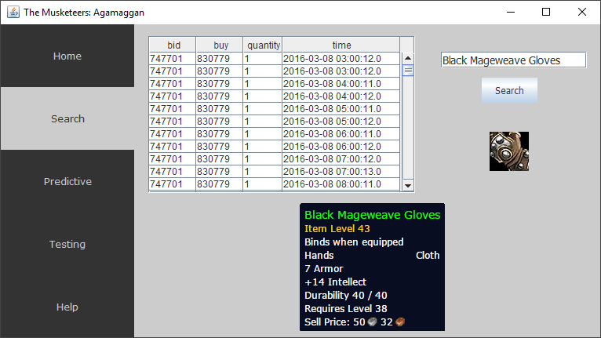
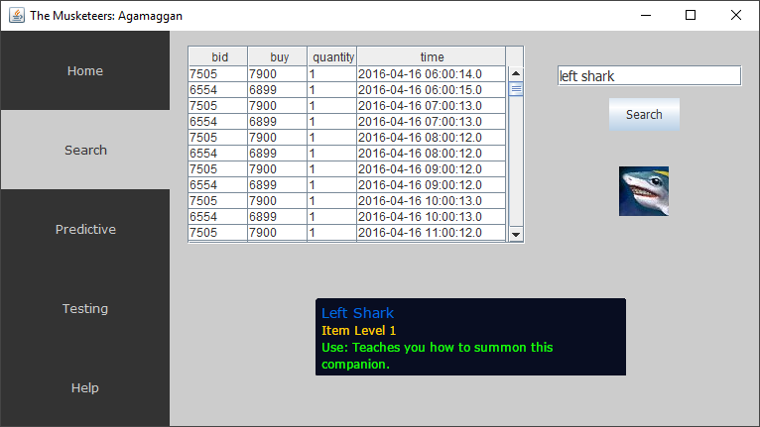
Results

Slide 40
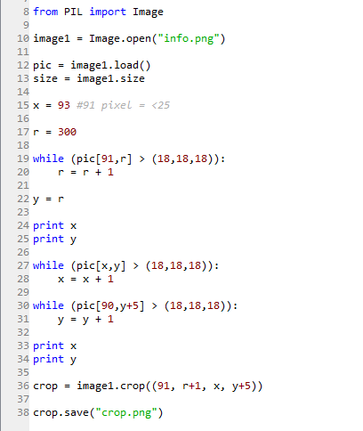
immark.py

Slide 41
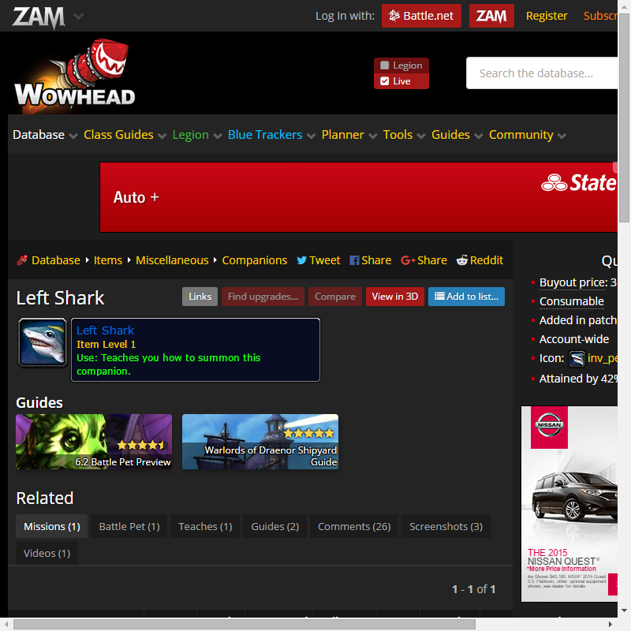
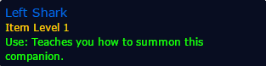
Results

Slide 42
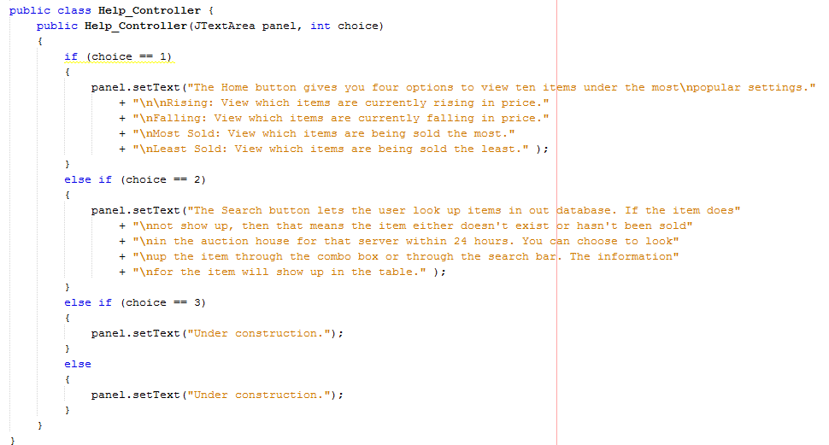
Help_Controller

Slide 43
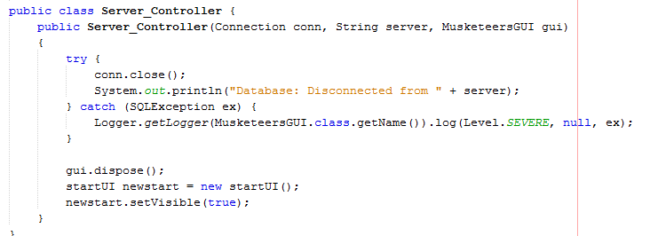
Server_Controller

Slide 44
GUI

